Slide 1
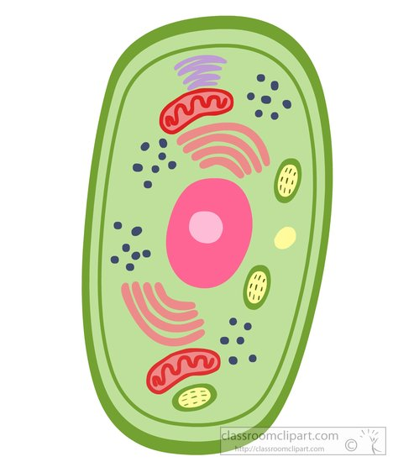
The Incredible, Edible Cell

Slide 2
What is a cell?
What is in a Cell?
Notes:
Write answers board if we have it
All living things are made of cells
What are major parts of cell

Slide 3
Parts of the Cell
Cell membrane
The walls
Ribosomes
The factory workers
Nucleus
The boss
Mitochondria
The energy makers
Cytoplasm
The jelly
Notes:
Nucleus
Cell membrane
Mitochondria
Ribosomes
Cytoplasm
Do you think that all parts of living things have the same kinds of cells? Do you think the cells in your brain are the same as the cells in your heart? Why or why not?
Animal vs plant cells?

Slide 4
Are there different types of cells?

Slide 5
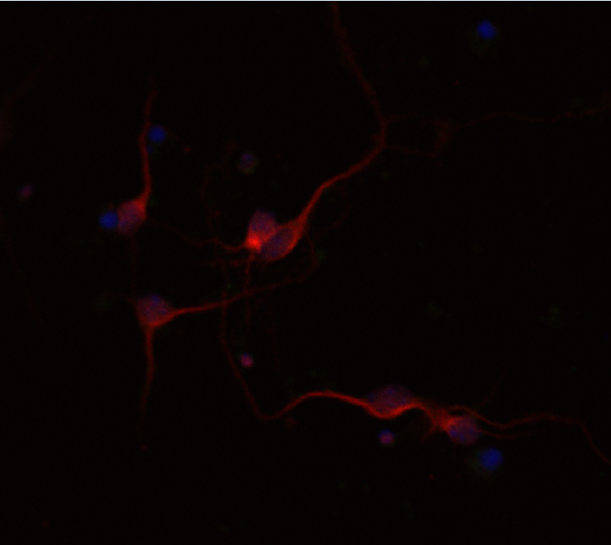
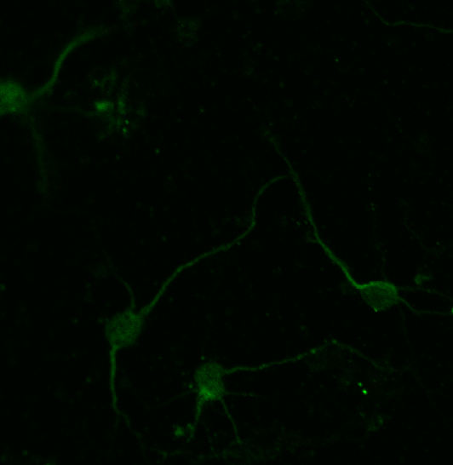
Cells from the brain (Neurons)
Notes:
Yes they are different, here are some examples

Slide 6
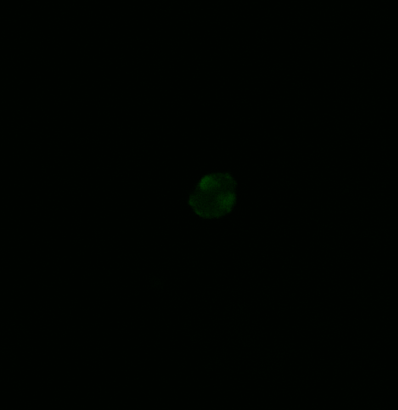
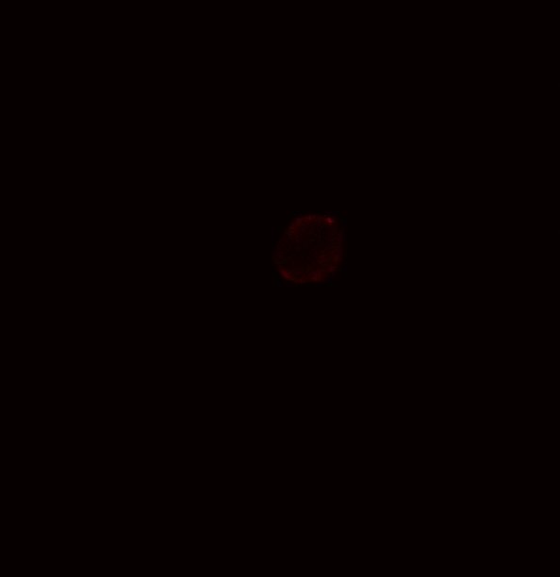
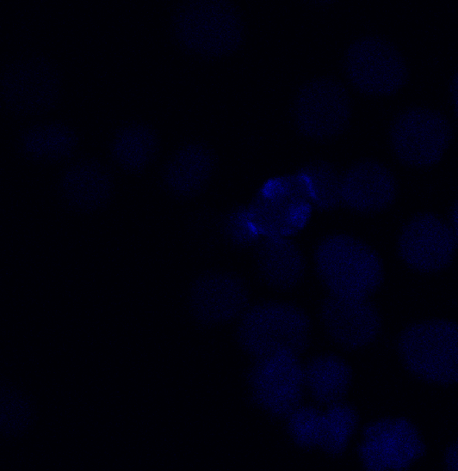
Cells from the lungs (Fibroblasts)
Cytoplasm
Plasma membrane
Nucleus

Slide 7
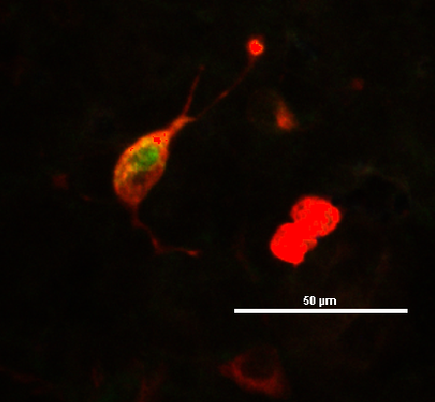
Cells from the Kidney (Hepatocytes)

Slide 8
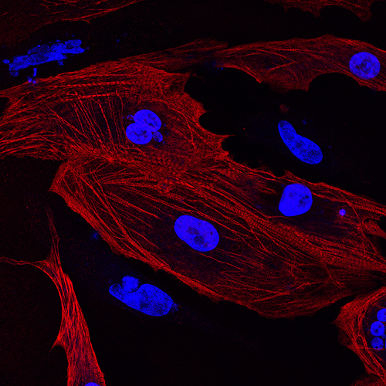
Cells from the heart (myocytes)
biobots

Slide 9
Time to look at Cells!

Slide 10
Parts of the Cell
___________
The walls
______________
The factory workers
_____________
The boss
_________________
The energy makers
_____________
The jelly
Notes:
Nucleus
Cell membrane
Mitochondria
Ribosomes
Cytoplasm
Do you think that all parts of living things have the same kinds of cells? Do you think the cells in your brain are the same as the cells in your heart? Why or why not?
Animal vs plant cells?

